Slide 1
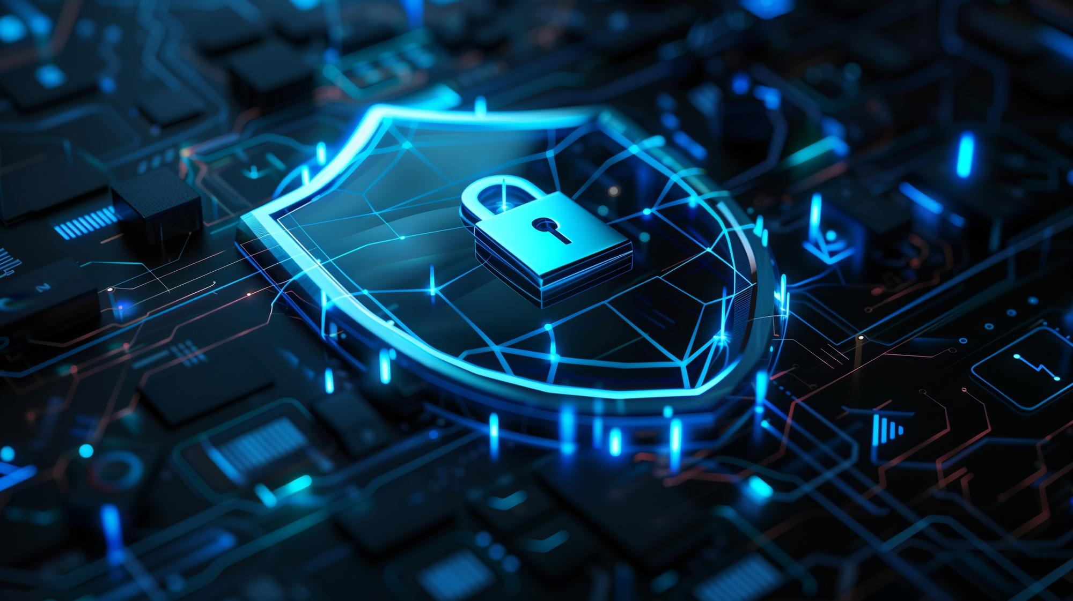
Computer Components at Stake!
How Cybersecurity Breaches Affect Our Digital Lives

Slide 2
Learning Outcomes
By the end of this presentation, you will understand:
The major touchpoints of our digital life that are at risk of Cyber Attacks.
Specific vulnerabilities of computers, mobile devices, social media, and IoT systems.
The types of security breaches that can affect digital components.
Basic preventive measures to protect digital assets from cyber threats.

Slide 3
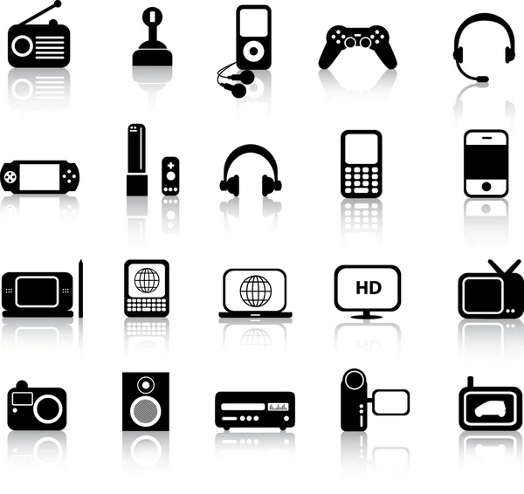
The Digital World and Cybersecurity Threats
Brief overview of the modern digital ecosystem: “In today’s world, nearly every aspect of life is integrated with technology. From personal devices to smart homes, we are increasingly dependent on the digital world.”
Introduction to cybersecurity risks: “With greater digital connectivity comes increased risk. Security breaches target various computer components, from PCs and smartphones to IoT devices and payment systems.”
State the objective: “In this presentation, we will explore the key touchpoints in our digital lives and understand the components most vulnerable to cyber threats.”

Slide 4
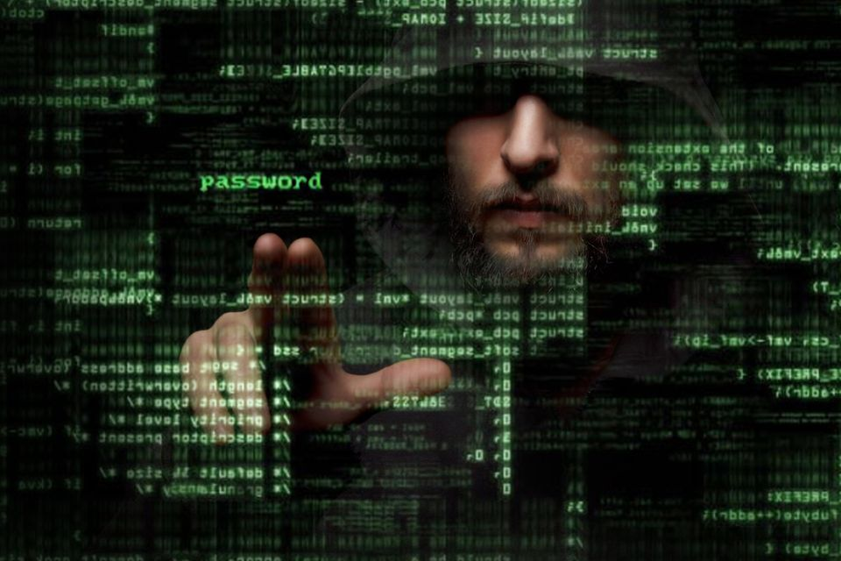
What is a Security Breach ?
Definition of a security breach: “A security breach occurs when an unauthorized party gains access to systems, networks, or data.”
Mention common types of breaches:
Malware: Program or file that's intentionally harmful to a computer, network or server. eg., Viruses, worms, trojans.
Ransomware: Locking data in exchange for ransom (e.g., the 2017 WannaCry attack).
Data theft: Stealing personal or financial data.
Phishing: Fraudulent attempts to obtain sensitive information.
Impacts of breaches: financial losses, reputation damage, personal harm, etc.

Slide 5
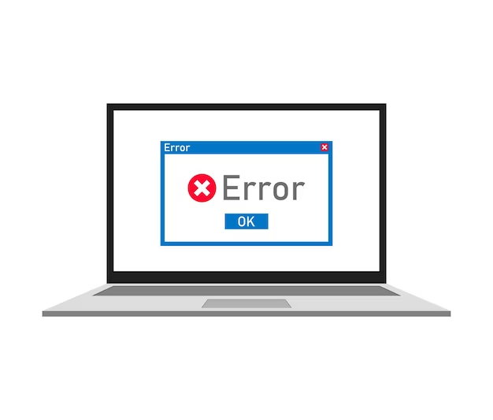
Cybersecurity Vulnerabilities in Computers
Why computers are at risk: “Personal computers are the backbone of professional and personal digital life. However, they are often targeted due to weak security settings.”
Key vulnerabilities:
Outdated software: Unpatched systems are prime targets.
Weak passwords: Easily guessable passwords compromise systems.
Phishing attacks: Emails designed to trick users into revealing sensitive information.
Public Wi-Fi risks: Using insecure networks opens the door to man-in-the-middle attacks.
Note:
Man-in-the-middle attacks: Hackers intercept communication between user and an application.

Slide 6
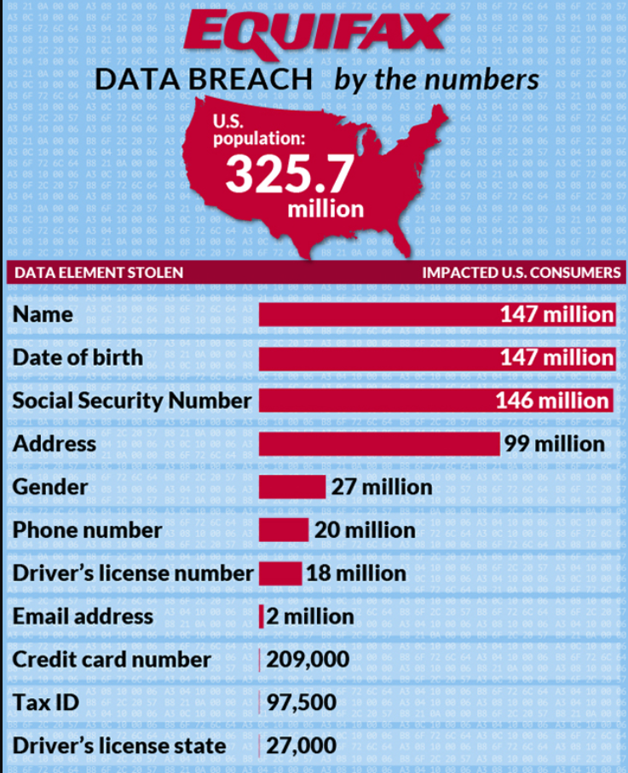
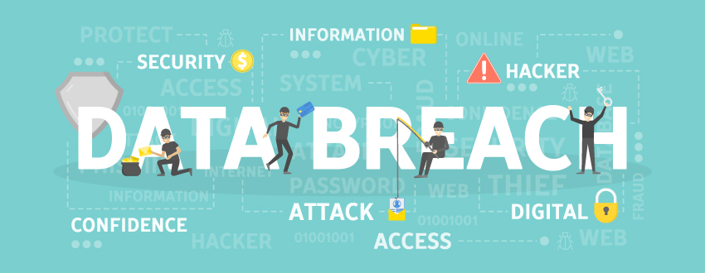
Example : Equifax Data Breach 2017
In September of 2017, Equifax announced a data breach that exposed the personal information of 147 million people. The company has agreed to a global settlement with the Federal Trade Commission, the Consumer Financial Protection Bureau, and 50 U.S. states and territories.

Slide 7
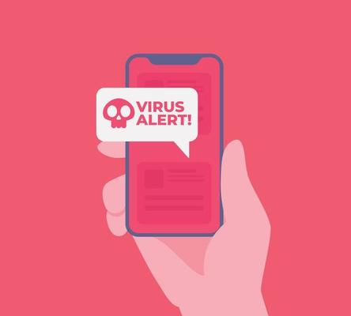
Mobile Devices and Cyber Threats
Why mobile devices are at risk: “Mobile phones store immense amounts of sensitive data—contacts, bank info, messages—but are often left unprotected.”
Types of attacks on mobile devices:
Mobile malware: Apps with malicious code.
Rogue apps: Unverified apps from non-official sources.
Insecure Wi-Fi and Bluetooth: Devices can be hacked through public networks.
SIM swapping: Hackers gain control of mobile numbers to bypass 2FA (two-factor authentication).
Protection strategies: Regular updates, verified apps, and secure connections.

Slide 8
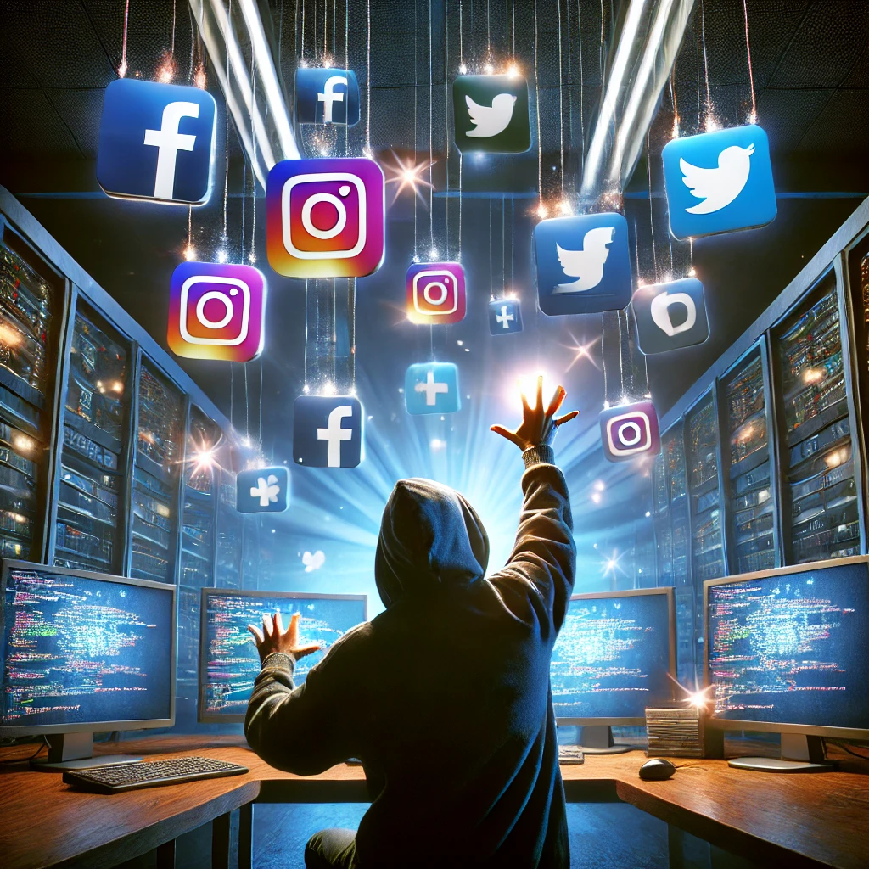
How Social Media Platforms Are Exploited
Risks on social media: “Social media has become an integral part of life, but it also exposes users to various cyber threats.”
Major social media risks:
Phishing and scams: Fake messages tricking users into giving up sensitive information.
Identity theft: Hackers steal personal data to impersonate users.
Data breaches: Platforms like Facebook have suffered massive breaches (e.g., the 2018 Cambridge Analytica scandal).
Oversharing: People sharing too much information on social media can lead to doxxing or other risks.
Note:
Doxxing: (sometimes spelled Doxing or D0xing) Act of revealing personal information about someone online without their consent.

Slide 9
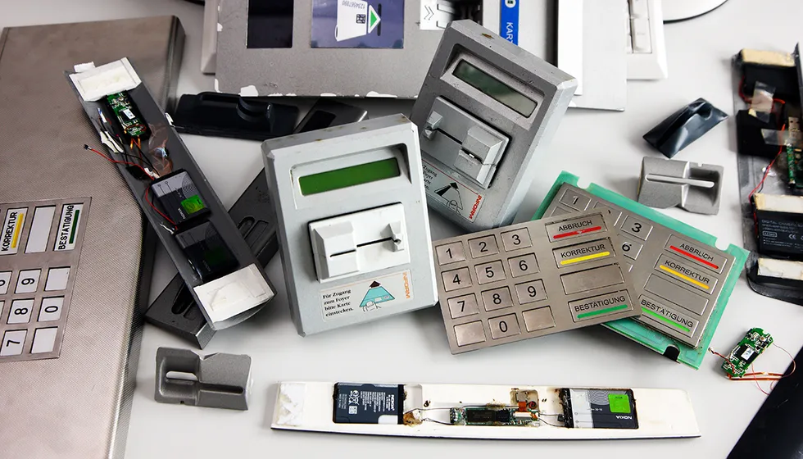
Cybersecurity in Digital Banking
Importance of digital banking: “With the rise of digital transactions, financial data is constantly at risk.”
Common vulnerabilities in banking:
Phishing emails: Fake banking notifications that steal credentials.
Man-in-the-middle attacks: Hackers intercept communication between user and bank.
Skimming devices: Physical devices attached to ATMs to steal card information.
Weak encryption: Inadequate security in banking apps can expose sensitive information.
Real-world example: Discuss a notable breach, like the 2020 Capital One breach affecting over 100 million users.

Slide 10
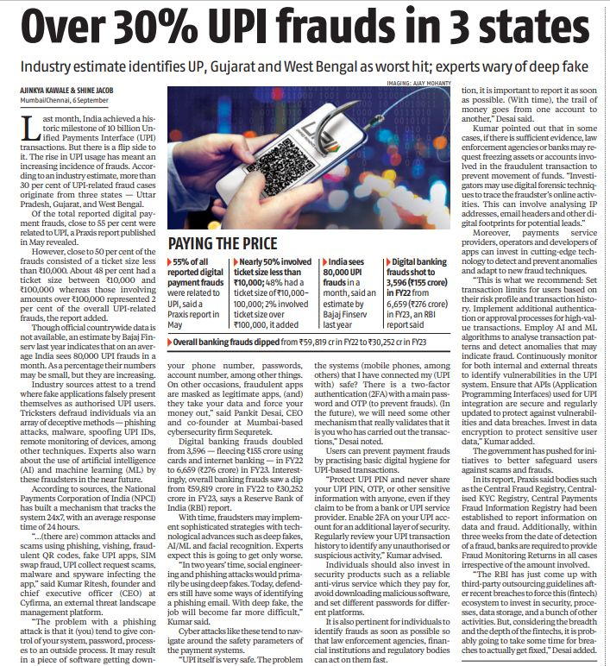
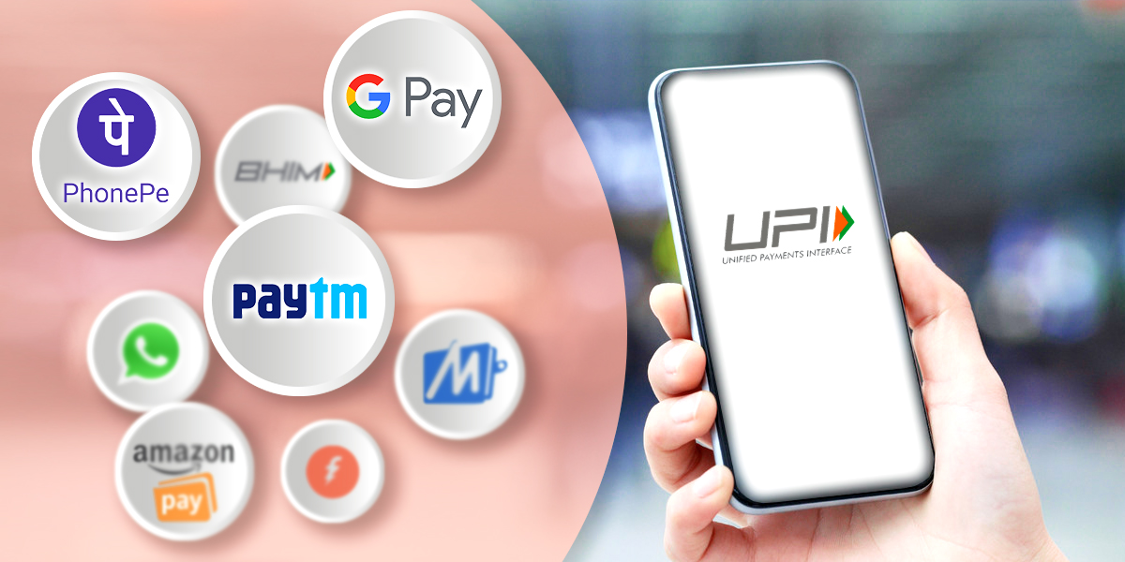
UPI Related Frauds
Recent Case :-
In 2023, a Mumbai businessman was scammed while selling furniture online. A fraudster posing as a buyer sent him a QR code, claiming it was for payment. When the businessman scanned the code, instead of receiving money, ₹1.5 lakh was deducted from his account. The QR code was actually used to authorize a payment to the scammer.

Slide 11
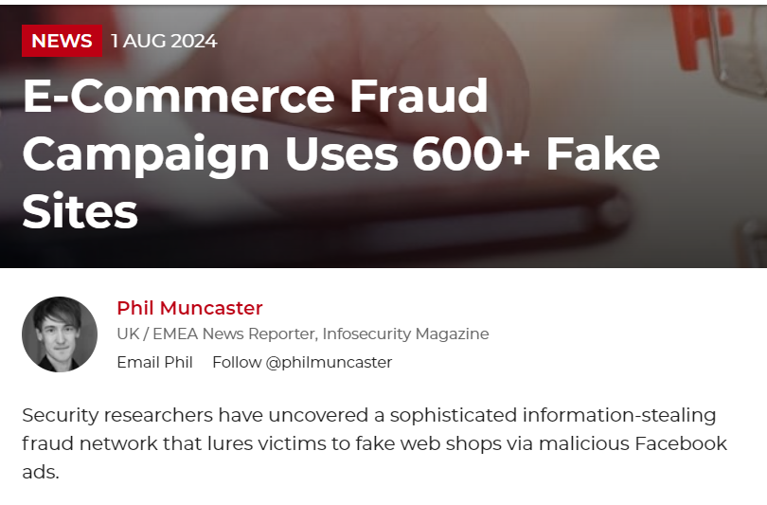
E-commerce: Securing Online Transactions
E-commerce growth and risks: “With millions of daily transactions, e-commerce is a prime target for cyberattacks.”
Key security risks:
Payment gateway vulnerabilities: Weaknesses in the systems that process online transactions.
Data breaches: Hackers can access stored credit card information from poorly secured websites.
Fake websites and phishing: Imitation e-commerce sites that steal customer information.
Protection methods: Secure payment gateways, encryption, and multi-factor authentication.

Slide 12
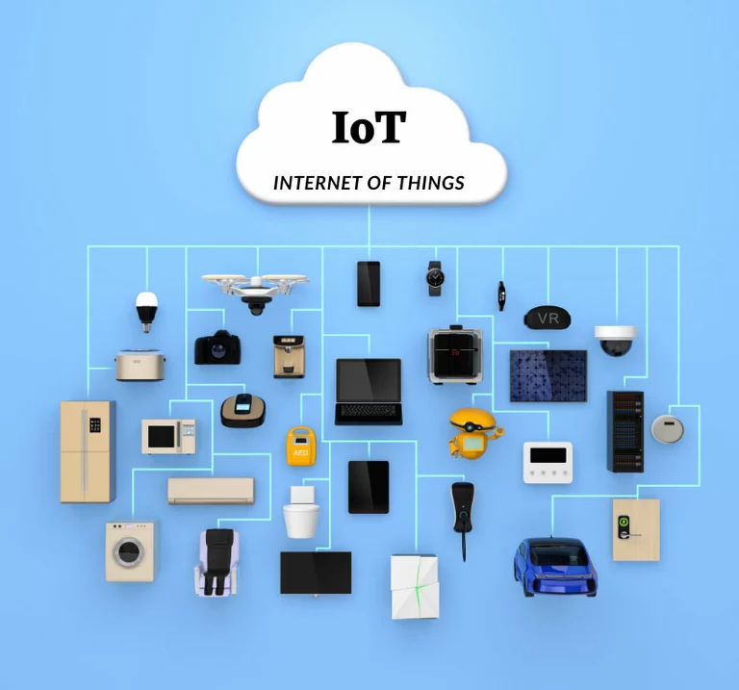
Internet of Things (IoT): The Expanding Attack Surface
What are IoT devices?: “IoT devices are everyday objects connected to the internet—ranging from smart home devices to cars.”
Why IoT is vulnerable:
Limited security: Many IoT devices lack strong security protocols.
Botnets: Devices can be infected and used as part of botnets in Distributed Denial of Service (DDoS) attacks.
Smart home hacks: Hackers can control smart lights, cameras, or thermostats if devices are compromised.
Car hacking: Modern cars with digital interfaces can be hacked, putting drivers at risk.

Slide 13
Activity

Slide 14
Which of these is a major touchpoint at risk of cyber attacks?
A) Personal emails only
B) Social media accounts, IoT systems, and mobile devices
C) Only computers at work
D) None of the above

Slide 15
What is a specific vulnerability of mobile devices in terms of cybersecurity?
A) Slow processing speed
B) Easily lost or stolen, and often used over public Wi-Fi
C) Inability to connect to the internet
D) Lack of storage space

Slide 16
Which type of security breach involves unauthorized access to user credentials on social media?
A) Phishing
B) Ransomware
C) DDoS attack
D) None of the above

Slide 17
How can users protect their IoT systems from cyber threats?
A) By using the default passwords provided by manufacturers
B) By updating firmware and using strong, unique passwords
C) By disabling all security features
D) By never connecting them to the internet

Slide 18
Which basic preventive measure can protect digital assets from cyber threats?
A) Ignoring software update notifications
B) Regularly updating software and systems, using antivirus programs, and avoiding suspicious links
C) Sharing passwords with friends
D) Turning off devices when not in use

Slide 19
Here are the answers:
B) Social media accounts, IoT systems, and mobile devices
B) Easily lost or stolen, and often used over public Wi-Fi
A) Phishing
B) By updating firmware and using strong, unique passwords
B) Regularly updating software and systems, using antivirus programs, and avoiding suspicious links

Slide 20

Conclusion: Securing Our Digital World
Summarize key points: "As our digital world grows, so do the threats. From computers to smart homes, every component of our digital life can be targeted."
Call to action: "Stay informed, implement security measures, and be vigilant about protecting your digital life from cyber threats."

